Slide 1
STACK

Slide 2
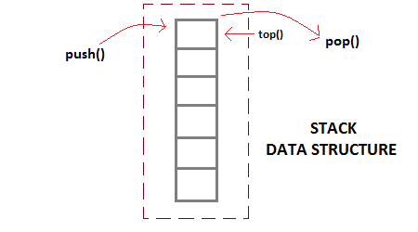
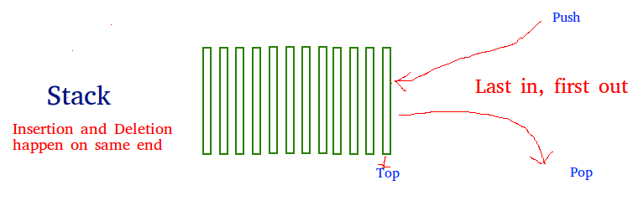
STACK - DATA STRUCTURE
Stack is a linear data structure which follows a particular order in which the operations are performed.
The order may be LIFO(Last In First Out) or FILO(First In Last Out).

Slide 3
FEATURES OF STACK DATA STRUCTURE
Stack is an ordered list of similar data type.
Stack is a LIFO(Last in First out) structure or we can say FILO(First in Last out).
push() function is used to insert new elements into the Stack and pop() function is used to remove an element from the stack. Both insertion and removal are allowed at only one end of Stack called Top.
Stack is said to be in Overflow state when it is completely full and is said to be in Underflow state if it is completely empty.
STACK ERRORS
Underflow: an attempt was made to pop an empty stack. Stack underflow is a common error - calls to isEmpty should be used to guard against it.
Overflow: an attempt was made to push an item onto a full stack. Some implementations of stacks specify a particular finite size. Others may attempt to emulate infinite stacks (of course, we know that everything in the real world is finite) and only result in stack overflow errors when the computer runs out of memory. Stack overflow is probably most commonly due to recursion that has "gone too far."

Slide 4
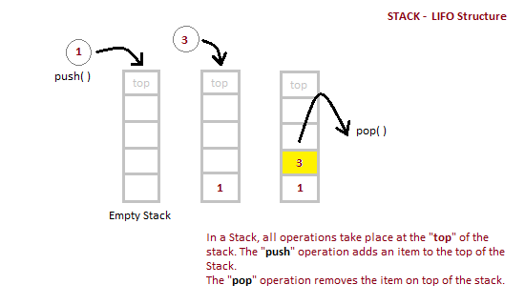
IMPLEMENTATION OF STACK DATA STRUCTURE
Stack can be easily implemented using an Array or a Linked List. Arrays are quick, but are limited in size and Linked List requires overhead to allocate, link, unlink, and deallocate, but is not limited in size. Here we will implement Stack using array.

Slide 5
OPERATIONS OF STACK DATA STRUCTURE
Operations on stack
Push Operation
Pop Operation
Top Operation
Search Operation
Time complexity
O(1)
O(1)
O(1)
O(n)
Status of Stack
Stack is Empty
Only one element in Stack
Stack is Full
Overflow state of Stack
Position of Top
-1
0
N-1
N
The time complexities for push() and pop() functions are O(1) because we always have to insert or remove the data from the top of the stack, which is a one step process.
push - add a new item on top of the stack
pop - remove the top item from the stack
isEmpty - check if the stack is empty
size - count the number of items on the stack

Slide 6
ALGORITHM FOR PUSH OPERATION
Check if the stack is full or not.
If the stack is full, then print error of overflow and exit the program.
If the stack is not full, then increment the top and add the element.
ALGORITHM FOR POP OPERATION
Check if the stack is empty or not.
If the stack is empty, then print error of underflow and exit the program.
If the stack is not empty, then print the element at the top and decrement the top.

Slide 7
APPLICATIONS OF STACK
Syntax Parsing
Expression Evaluation and Conversion
Function call
Parenthesis checking
String Reversal
Memory Management.
Backtracking problems

